Slide 1






Cloning Apps and Items with ArcGIS API for Python
John Yaist
Raul Jimenez Ortega

Slide 2
Topics
Cloning Content Scenario
Demo – Cloning Hosted Feature Layers and Webmaps
Discussion – clone_items() function and key parameters
Demo – Cloning Dashboards and Web Mapping Applications

Slide 3




Staging
Production
Staging
Dashboard
Dashboard
Apps
Apps
Apps
Desktop
Desktop
Desktop
Webmap
Webmap
Webmap
Webmap
Webmap
Story Map
Webmap
Story Map
APIs
APIs
APIs
Layers
Layers

Slide 4
Demo: Cloning Feature Layers and Webmaps

Slide 5



Accessing the function
Content Manager

Slide 6
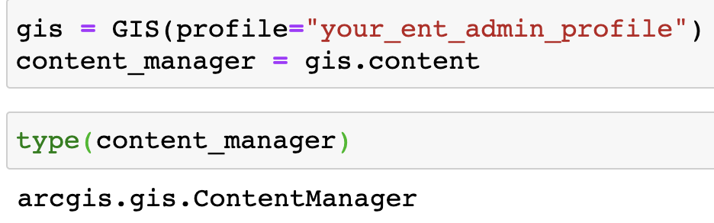


ContentManager
Accessed from the content property of a GIS object
clone_items() is a method on the ContentManager
https://developers.arcgis.com/python/api-reference/arcgis.gis.toc.html#arcgis.gis.ContentManager.clone_items

Slide 7

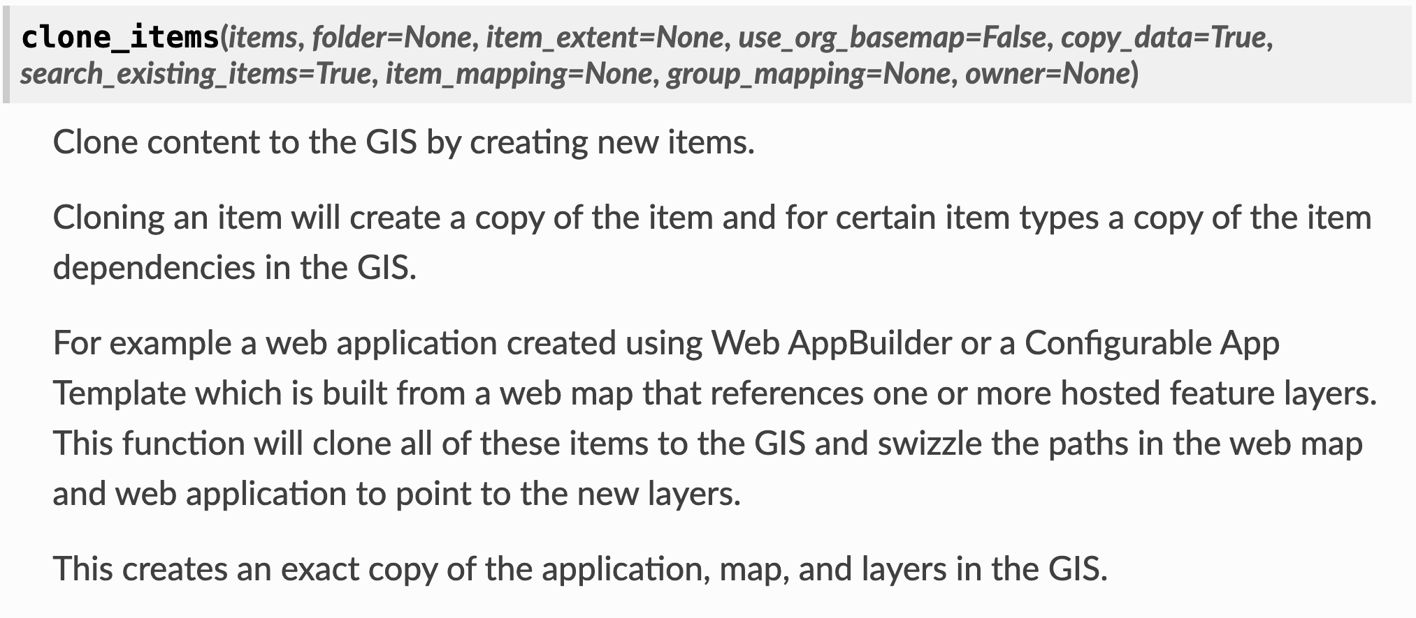
clone_items()

Slide 8
Key Parameters
search_existing_items
default value = True
item_mapping
optional dictionary

Slide 9

search_existing_items
uses the item typeKeyword property to label result
cloned items have a typeKeyword formatted like below added:
source-<itemId>
example: Feature Layer item id e9541fd18bdc439dbf84ef7e929475ac.
cloned item typeKeyword: source-e9541fd18bdc439dbf84ef7e929475ac

Slide 10

item_mapping
uses an existing item in the target GIS
useful for items comprised of items:
Web Mapping Applications
ArcGIS Dashboards
clone_items()
does not automatically clone all items comprising more complex item types

Slide 11

Demo: Cloning ArcGIS Dashboards and Web Mapping Applications

Slide 12
Conclusion
search_existing_items=True – prevents duplication of previously cloned items
Webmaps – Feature Layers are cloned by default
Feature Layers – data is cloned by default
cloning Web Mapping Applications and Dashboards
use item_mapping to control which items serve particular roles

Slide 13
ArcGIS API for Python Cloning Content Guide
https://developers.arcgis.com/python/guide/cloning-content/

Slide 14
Please share your feedback via the survey
available at the link below the presentation.

Slide 15
ArcGIS API for Python Cloning Content Guide
https://developers.arcgis.com/python/guide/cloning-content/

Slide 16








Copyright © 2021 Esri. All rights reserved.

